Slide 1
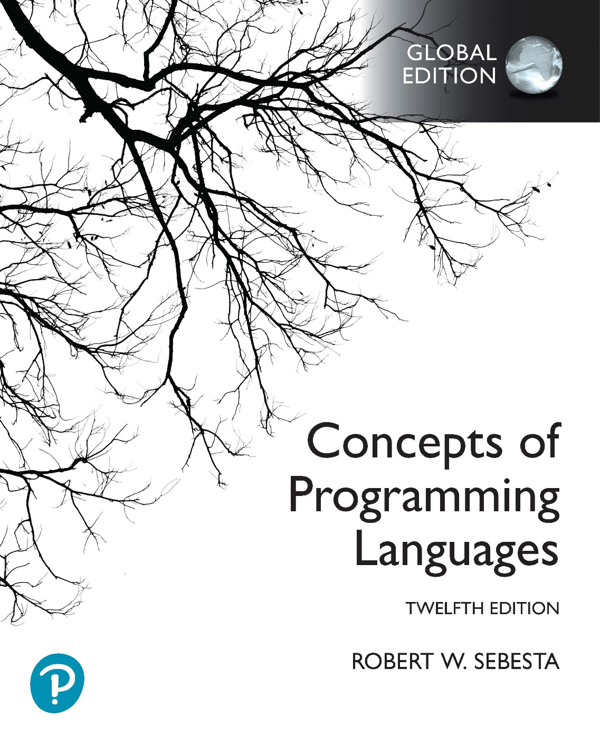
Chapter 15 Part 3
Functional Programming Languages

Slide 2
Chapter 15 Topics
Introduction to Scheme
Example Scheme Functions
Tail Recursion in Scheme
An Apply-to-All Function
Functions That Build Code
COMMON LISP
Functional Language Applications
Comparison of Functional and Imperative Languages

Slide 3
Example Scheme Function: equalsimp
The equalsimp function
Applied to two simple lists (lis1 and lis2)
Yields #t if lis1 and lis2 are equal, #f otherwise
Strategy: Recursively compare list element pairs; Yield #t if both lists exhausted simultaneously, #f if an element pair is unequal or one list is exhausted before the other
(define (equalsimp lis1 lis2)
(cond
((null? lis1) (NULL? lis2))
((null? lis2) #F)
((eq? (car lis1) (car lis2))
(equalsimp(cdr lis1)(cdr lis2)))
(else #F)
)
)
Notes:
This example defines a function named equalsimp, which is applied to two parameters, lis1 and lis2 (both lists). The lists are both “simple”, meaning that we assume they hold only atoms, and no sublists. The function results in a true if the lists contain exactly the same elements, and false otherwise.
The function is again recursive, because it uses the equalsimp function. It has three base cases, and one recursive case.
Our strategy is as follows: We compare the first element in each list. If we see that they’re the same, we can continue checking the rest of the lists by ignoring the first elements of each and testing the tails. We can conclude they the lists aren’t the same if we find one pair of elements that doesn’t match. Also, if one of the lists runs out of elements before the other, the lists are different lengths, so we can conclude that they aren’t equal.
The first two base cases deal with either the first or second list being empty. Look at the first base case. It tests whether the first list is empty. If the first list is empty, then we need to look at the second list. If the second list is also empty, then the two lists are equal (they are both empty lists). If the second list is not empty (it contains one or more elements), then the lists obviously aren’t equal (lis2 is longer than lis1). In other words, if the second list is empty, the null? function produces a #t result, and the equalsimp function’s result is also #T. If the second list is not empty, the null? function produces a #f result, which also becomes the result of equalsimp.
Let’s look at the second base case. Remember that the first base case has eliminated the possibility that lis1 is empty. So if lis2 is empty, we know lis1 must be longer than lis2, and therefore the lists are not equal. The result is therefore #f, and we don’t need to check whether lis1 is empty.
The final base case is for when both lists still have elements, but we’ve found that the first elements in each don’t match. Obviously we know that the lists can’t be equal in this case. Now we could have checked for that explicitly (can you write the predicate that would test this?), but because the recursive case needs to handle the situation where the first elements in each list match, we can simply specify it as the else part, which will be used if none of the previous tests are successful. If we have eliminated all the conditions before the else, we can see that the only other outcome possible is if the first elements in the lists don’t match, and the result must be #f.
Now for the recursive case. What we want to do here is confirm that the first elements of the two lists are the same. This is done using the eq? function on the car of each list. If the elements match, we know we can continue testing the remaining elements in the lists. So we ignore the first elements (we’ve already found that they’re the same) and call the equalsimp function itself on the cdr of each list. This will continue until either the first list or the second runs out of elements before the other list (the first two base cases), an element is found that doesn’t match (the final base case), or both lists run out of elements at the same time (the first base case again). Only in the last case do we get a #t.
Again, we have to solve this problem recursively, not iteratively.
Now consider the order of the base and recursive cases. What happens if we move the recursive case to the top of the cond? What happens if we place the null? check on lis2 above the null? check on lis1? If we have an explicit test to check for when the first elements in the lists don’t match, where can we place it?

Slide 4
Example Scheme Function: equal
The equal function
Applied to two general lists (lis1 and lis2)
Yields #t if the two lists are equal, #f otherwise
Strategy: Same as equalsimp, but adapted to compare atoms and lists; Use equal to compare list element pairs
(define (equal lis1 lis2)
(cond
((not (list? lis1))(eq? lis1 lis2))
((not (list? lis2)) #f)
((null? lis1) (null? lis2))
((null? lis2) #f)
((equal (car lis1) (car lis2))
(equal (cdr lis1) (cdr lis2)))
(ELSE #f)
)
)
Notes:
The issue with the previous program is that it doesn’t work if we have sublists in either lis1 or lis2. Why is this? Because eq? has unpredictable results when it compares lists (see the previous lecture for details on this). This function overcomes this problem.
Compare this function to equalsimp. You’ll see that the three base cases and the recursive case are almost the same. Firstly, we’ve replaced the eq? function with another recursive call to the equal function. What is the result of this? Because the equal function tests whether two lists are equal, it will now be able to compare items in lis1 and lis2 that are also lists. Are we done? Not yet. We’ve now also removed the mechanism for testing individual atoms (we don’t use eq? in the predicate of the recursive case, and equalsimp doesn’t have base cases to deal specifically with atoms). So how do we solve this? We need to add base cases to handle atoms.
The additional base cases are at the top of the program. The first one tests whether lis1 is not a list. This will only be the case if lis1 is an atom. In that case we use eq? on lis1 and lis2. Remember that eq? returns true if its parameters are atoms that are the same, and false otherwise. So if lis1 is an atom, and lis2 is the same atom, the result is #t. Obviously if lis1 and lis2 are different atoms, the result is #f. What if lis1 is an atom, but lis2 is a list? The eq? fails, and the result is #f, as we expect. So all of these cases are handled by the first base case.
Now let’s consider what we haven’t handled yet. We need to look at the case where lis1 is a list, and lis2 is an atom. This is handled by the second base case, which is triggered if lis2 is not a list (i.e. an atom). Because of the first base case, we know lis1 can’t be an atom, so it must be a list. So the second base case only handles the case where lis1 is a list, and lis2 is an atom. In this case the result must obviously be #f.

Slide 5
Example Scheme Function: append
The append function
Applied to two lists (lis1 and lis2)
Yields new list containing the elements of lis1 followed by the elements of lis2
Strategy: Prepend lis1 elements to lis2 in reverse order
Why can’t we append lis2 to lis1 atom by atom?
Why can’t we use the LIST function to do the appending?
(define (append lis1 lis2)
(cond
((null? lis1) lis2)
(else (cons (car lis1) (append (cdr lis1) lis2)))
)
)
(append (A B) (C D))
(append (B) (C D))
(append () (C D)) → (C D)
(append (B) (C D)) → (CONS B (C D)) → (B C D)
(append (A B) (C D)) → (CONS A (B C D)) → (A B C D)
Notes:
This example is a bit simpler than the previous one. Here we want to append lis2 to lis1.
The function has a base case and a recursive case. The base case handles the case where lis1 is empty. In this case the result is simply lis2, because it has been appended to nothing.
The recursive case adds the head of lis1 to the result of appending lis2 to the tail of lis1. So the result is that lis2 is passed along lis1, until the end of lis1 (remember, there is effectively an empty list at the end of every list). This produces lis2, and then we use cons to add the last element in lis1 to lis2. Then we add the second last element. Then the third last. And so on until we reach the first element in lis1, which is also added to the resulting list.
So we get something like this, given the code (append (A B) (C D)):
(cons A (append (B) (C D)))
Then (append (B) (C D)) => (cons B (append () (C D)))
Then (append () (C D)) => (C D)
And substituting results back as the recursive calls terminate:
(cons B (C D)) producing the list (B C D)
(cons A (B C D)) producing the list (A B C D)
Now try to answer the question on this slide (Hint: consider what will happen if you use cons to append C to (A B), and also what will happen if you use the list function instead of cons).

Slide 6
Tail Recursion in Scheme
Recursive functions
Slower than equivalent iterative constructs
Use more memory than equivalent iterative constructs
A tail recursive function
The recursive call is the last operation in the function
Implication
Compiler can automatically converted to iteration
Makes the function much faster and resource efficient
Scheme language definition requires all tail recursive functions to be converted to iteration

Slide 7
Tail Recursion in Scheme (continued)
Rewriting to make a function tail recursive
(define (factorial n)
(if (= n 0)
1
(* n (factorial (- n 1)))
)
)
(factorial 3) → (* 3 (factorial 2))
(factorial 2) → (* 2 (factorial 1))
(factorial 1) → (* 1 (factorial 0))
(factorial 0) → 1
(factorial 1) → (* 1 1) → 1
(factorial 2) → (* 2 1) → 2
(factorial 3) → (* 3 2) → 6
(define (facthelper n partial)
(if (<= n 1)
partial
(facthelper (- n 1) (* n partial))
)
)
(define (factorial n)
(facthelper n 1)
)
(factorial 3)
(facthelper 3 1) → (facthelper 2 (* 3 1))
(facthelper 2 3) → (facthelper 1 (* 2 3))
(facthelper 1 6) → 6
(facthelper 2 3) → 6
(facthelper 3 1) → 6
(factorial 3) → 6
Notes:
The first example is a standard recursive implementation for computing a factorial. Make sure you understand how it works. The result in this case is built up as follows (I’m using C style notation so that it’s easier to follow):
fact(3) = 3 * fact(2)
call fact(2) = 2 * fact(1)
call fact(1) = 1 * fact(0)
call fact(0) = 1
And then unwinding the recursive calls:
fact(1) = 1 * 1 = 1
fact(2) = 2 * 1 = 2
fact(3) = 3 * 2 = 6
This example is not tail recursive. Why? Because when the recursive case is evaluated, we first have to apply factorial to the result of (- n 1), and then we have to multiply n by the result of the factorial function. So * is the last function evaluated, not factorial. Also, as you can see, the result is computed during the unwinding of the recursive functions.
In the second example, we instead compute a partial result, and pass it along to the next recursive call. We also need to keep track of how many recursive calls we have left. The result is then simply returned as the recursive functions terminate. In other words:
factorial(3)
call facthelper(3, 1)
call facthelper(2, 3 * 1) = facthelper(2, 3)
call facthelper(1, 2 * 3) = facthelper(1, 6)
The last factpartial is 6, so the recursive call unwind as follows:
facthelper(1, 6) = 6
facthelper(2, 3) = 6
facthelper(3, 1) = 6
factorial(3) = 6
So you can see that the first parameter, n, is used to keep track of how many recursive calls we need to perform (it counts down from 3 to 1, almost like a loop control variable in a for loop, even though it isn’t a variable). The second parameter stores the partial result, which we modify with each recursive call.
It is clear that the second example is tail recursive, because the multiplication and subtraction are performed first, and the results are used as parameters for facthelper. Also, we compute the result through the initial recursive calls, and simply send the result back while the calls are unwinding.

Slide 8
An Apply-to-All Function
A functional form is a function that
Takes one or more functions as parameters, and/or
Yields a function as a result
Apply-to-all functional form
Apply a function to all elements of a list, building a new list
One approach in Scheme is the following mapcar function
(define (mapcar fun lis)
(cond
((null? lis) ())
(else (cons (fun (car lis)) (mapcar fun (cdr lis))))
)
)
To use: (mapcar (lambda (num) (* num num)) '(3 4 2 6))
Notes:
The mapcar function has two parameters, fun and lis. The fun parameter is a function, which must be applied to every element in lis.
So how does this work? Again, we solve it recursively. The recursive case (in the else code) handles the situation where there are still elements in list to process. It applies fun to the first element in the list (which we get using car). It then calls mapcar on the tail of lis (which we get using cdr). Finally, it creates a new list using cons, which contains the result of applying fun to the first element, appended to the list produced for the tail. The base case is used when we get to the end of lis. In this case, the result is just an empty list.
You can see in the last example that we can use a lambda function as the first parameter, and have it applied to every element in the list. The recursive calls would look like this (I’m just going to use the symbol f to represent the lambda function):
(mapcar f (3 4 2 6))
calls (cons (f 3) (mapcar f (4 2 6))) = (cons 9 (mapcar f (4 2 6)))
calls (mapcar f (4 2 6))
calls (cons (f 4), (mapcar f (2 6))) = (cons 16 (mapcar f (2 6)))
calls (mapcar f (2 6))
calls (cons (f 2), (mapcar f (6))) = (cons 4 (mapcar f (6)))
calls (mapcar f (6))
calls (cons (f 6) (mapcar f ())) = (cons 36 (mapcar f ()))
calls (mapcar f ()) = ()
Then we unwind the recursive calls again:
(cons 36 ()) = (36)
(cons 4 (36)) = (4 36)
(cons 16 (4 36)) = (16 4 36)
(cons 9 (16 4 36)) = (9 16 4 36)
The final result is a new list containing the values produced by applying the anonymous function to the elements of the original list.
It’s also possible to use a named function as the first parameter for mapcar. For example, assume we have the following named function:
(define (square x)
(* x x)
)
We can now simply pass the square function as a parameter by using its name, as follows:
(mapcar square ‘(3 4 2 6))

Slide 9
Functions That Build Code
A Scheme function can actually
Build Scheme code
Request the interpretation of the built Scheme code
This is possible (and easy) because
Functions can be represented as lists, and can be returned
The interpreter is a user-available function, called EVAL

Slide 10
Functions That Build Code
A simple example
(define (adder lis)
(cond
((null? lis) 0)
(else (eval (cons '+ lis)))
)
)
The parameter is a list of numbers to be added
Builds a new list from the + symbol and lis
Use cons to insert the atom + into the list of numbers
Be sure that + is quoted to prevent evaluation
Evaluates the new list
Submit the new list to eval for evaluation
Notes:
This example is just a simple example to illustrate how a function can build code that can be executed. We can obviously build code that is as complex as we like.
The adder function has one parameter, lis, which is a list of numeric atoms. The adder function simply builds a new list containing the + symbol, followed by the elements in lis. It does this using a cons. Note that the + symbol must be quoted, because we don’t want it to be interpreted as the + function (which is provided by Scheme). So, if we imagine that lis is the list (13 2 5), then the cons produces a new list (+ 13 2 5). You can see that this has the form of normal Scheme function application, even though it’s just a list at this stage. Now we can apply EVAL to the list, which basically means “execute this list as if it had been typed into the Scheme interpreter”. What this does, of course, is apply the + function to the parameters 13, 2, and 5. The result is 20. Note that the numbers don’t need to be quoted, because they are simply numeric atoms, and can’t be confused with names.
The first condition is trivial. It just makes sure that when someone calls (adder ()) we don’t attempt to create a function like (+), which will obviously produce an error when Scheme tries to evaluate it. So if the list is empty, we just produce 0 as a result.
Note that the sicp implementation of Scheme requires a second parameter for the eval function, which denotes the environment of the evaluation. The eval function should be used as follows:
(eval (cons ‘+ lis) (scheme-report-environment 5))

Slide 11
COMMON LISP
A combination of many of the features of the popular dialects of LISP around in the early 1980s
A large and complex language
In a sense, the opposite of Scheme
Features include
Records
Arrays
Complex numbers
Character strings
Powerful I/O capabilities
Packages for organizing functions/data, & access control
Iterative control statements

Slide 12
Functional Language Applications
LISP
Used for artificial intelligence
Knowledge representation
Machine learning
Natural language processing
Modeling of speech and vision
End-user software
Emacs text editor & MACSYMA mathematics system
All system software on the LISP machine
Scheme
Used to teach introductory programming

Slide 13
Comparing Functional and Imperative Languages
Imperative Languages
Efficient execution
Complex semantics
Complex syntax
Concurrency is programmer designed
Functional Languages
Simple semantics
Simple syntax
Inefficient execution
Programs can automatically be made concurrent

Slide 14
Some Final Notes
Slides contain extensive notes
If you need more explanation of the examples, including step-by-step execution traces, look at these notes
In tests and exams I can ask you
Theory questions
What the result is of Scheme code
To explain how Scheme code executes
I can ask you to analyze or correct Scheme code
I can ask you to implement a Scheme function
Implementations will be no more complex than the examples we covered in these lectures
Be sure you understand the code examples
Be sure to do the functional programming practical

